Slide 1
Context Sensitive Analysis
Naming, Scoping and Symbol Table
Chapter-5 (Keith Cooper)
Nalinadevi Kadiresan, CSE DEPT.
AMRITA SCHOOL OF ENGG.

Slide 2
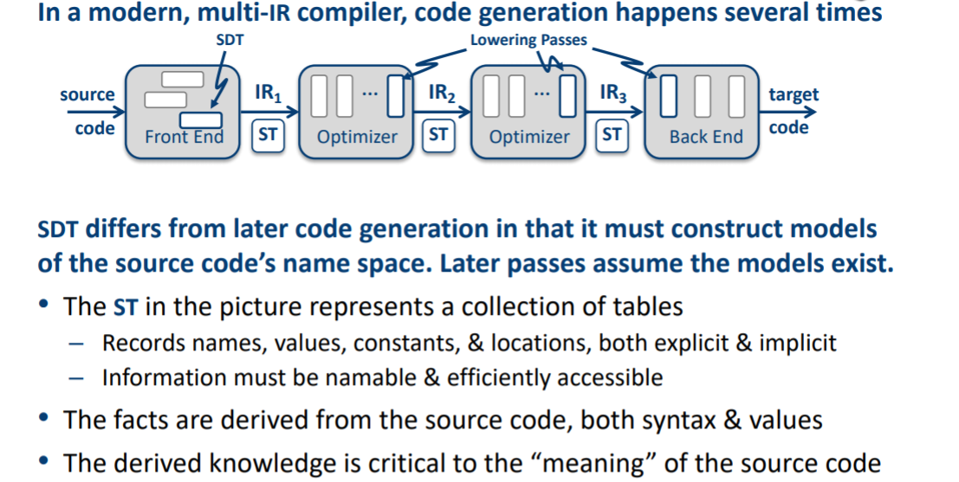
What is a Symbol Table(ST)?
This lecture focuses on a compiler builds up that knowledge base of names
Even Semester 2017-18
Nalinadevi Kadiresan

Slide 3
What are Names for a compiler?
Names are: variables, defined constants, procedures, functions, labels, structures, and files
 | Compiler Requirements
Variable | a data type, its storage class, the name and lexical level of its declaring procedure, a base address and offset in memory
Array | number of dimensions upper and lower bounds for each dimension
Records or structures | a list of the field relevant information for each field
Functions and procedures | number of parameters and their type the types of any returned values
Even Semester 2017-18
Nalinadevi Kadiresan

Slide 4
Recording Names
Recording names in AST built by parser
  information about variables are stored as annotations
  Adv: uses a single representation for the code being compiled
  Disadv: Navigating AST to find declaration is costly
  Alternate is central repository -Symbol table
  It reduces searching cost
  It eliminates the overhead of making each reference contain a pointer to the declaration
Even Semester 2017-18
Nalinadevi Kadiresan

Slide 5
Scope
Suppose that a name is used many times for different entities in text of the program, or in the course of execution. When the name is used, to which of these entities does it refer?

Slide 6
Scope and visibility
Scope (visibility) of identifier = portion of program where identifier can be referred to
Lexical scope = textual region in the program
  Statement block
  Method body
  Class body
  Module / package / file
  Whole program (multiple modules)

Slide 7
Lexical scoping in block structured language
Each scope (procedure or block) creates its own name space
  Any name (almost) can be declared locally
  Local names obscure identical non-local names
  Local names cannot be seen outside the scope
  Scopes are searched in the order that they were encountered
Algol and Pascal are the classic examples – Nested procedures, often with deep nesting
Fortran had local, static, and named global scopes
C has global, static, local, and block scopes
begin int x;
begin real x;
begin
y:=x;
end
end
end
Even Semester 2017-18
Nalinadevi Kadiresan

Slide 8
Lexical scoping in OO languages
Global scope
  The names of all classes defined in the program
Class scope
  Instance scope: all fields and methods of the class
  Static scope: all static methods
  Scope of subclass nested in scope of its superclass
Method scope
  Formal parameters and local variables in code block of body method
Code block scope
  Variables defined in block
Even Semester 2017-18
Nalinadevi Kadiresan

Slide 9
Symbol tables in block-structured languages
many small table - one symbol table per scopes
one global table - All names are in the same table.
  What about the same name is declared several times?
    Each name is given a scope number/level.
    <name, level> should be unique in the table.
Even Semester 2017-18
Nalinadevi Kadiresan

Slide 10
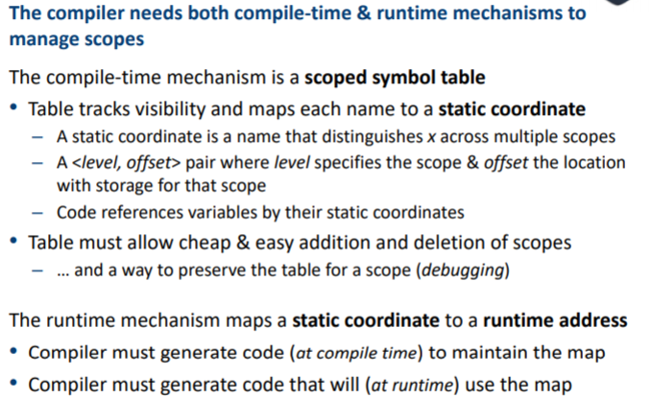
How does Compiler model the scope?
Even Semester 2017-18
Nalinadevi Kadiresan

Slide 11
Symbol Table
Proposed Implementation of lexically scoped symbol table
  Stack
  Sheaf-of-Tables
  Open Hashing
  Open Hashing + stack
  Open Addressing
  Two dimensional Hashed symbol Table
Notes:
A compiler uses a symbol table to keep track of scope and binding information about names. It is filled after the AST is made by walking through the tree, discovering and assimilating information about the names. There should be two basic operations – to insert a new name or information into the symbol table as and when discovered and to efficiently lookup a name in the symbol table to retrieve its information.
Two common data structures used for the symbol table are –
Linear lists:- simple to implement, poor performance
Hash tables:- greater programming/space overhead, good performance
Ideally a compiler should be able to grow the symbol table dynamically, i.e. insert new entries or information as and when needed. But if the size of the table is fixed in advance then ( an array implementation for example), then the size must be big enough in advance to accommodate the largest possible program.

Slide 12
Example- Nested scoping
procedure p {
int a, b, c
procedure q {
int v, b, x, w
procedure r {
int x, y, z
….
}
procedure s {
int x, a, v
…
}
… r … s
}
… q …
}
B0: {
int a, b, c
B1: {
int v, b, x, w
B2: {
int x, y, z
….
}
B3: {
int x, a, v
…
}
…
}
…
}
Even Semester 2017-18
Nalinadevi Kadiresan

Slide 13
Implementing Lexically Scoped Symbol Tables- Stack organization
growth
Implementation
insert () creates new level pointer if needed and inserts at nextFree
lookup () searches linearly from nextFree–1 forward
delete () sets nextFree to the equal the start location of the level deleted.
Advantage
Uses much less space
Disadvantage
Lookups can be expensive
nextFree
z
y
r (level 2)
x
w
x
b
q (level 1)
v
c
b
p (level 0)
a

Slide 14
Symbol Table
Proposed Implementation of lexically scoped symbol table
  Stack
  Sheaf-of-Tables
  Open Hashing
  Open Hashing + stack
  Open Addressing
  Two dimensional Hashed symbol Table
Notes:
A compiler uses a symbol table to keep track of scope and binding information about names. It is filled after the AST is made by walking through the tree, discovering and assimilating information about the names. There should be two basic operations – to insert a new name or information into the symbol table as and when discovered and to efficiently lookup a name in the symbol table to retrieve its information.
Two common data structures used for the symbol table are –
Linear lists:- simple to implement, poor performance
Hash tables:- greater programming/space overhead, good performance
Ideally a compiler should be able to grow the symbol table dynamically, i.e. insert new entries or information as and when needed. But if the size of the table is fixed in advance then ( an array implementation for example), then the size must be big enough in advance to accommodate the largest possible program.

Slide 15
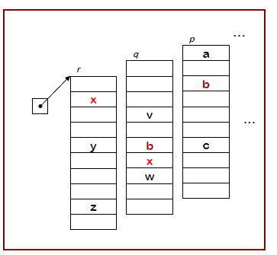
Implementing Lexically Scoped Symbol Tables- Dynamic Sheaf-of -Tables
Create a new table for each scope
Chain them together for lookup
“Sheaf of tables” implementation
insert() may need to create table, it always inserts at current level
lookup() walks chain of tables & returns first occurrence of name
delete() throws away table for level p, if it is top table in the chain
If the compiler must preserve the table (for, say, the debugger ), this idea is actually practical.
Individual tables can be hash tables.
Even Semester 2017-18
Nalinadevi Kadiresan

Slide 16
Dynamic Sheaf-of -Tables
Final table
p
s
q
a
b
c
r
v
b
x
w
x
a
v
.
x
y
z
Even Semester 2017-18
Nalinadevi Kadiresan

Slide 17

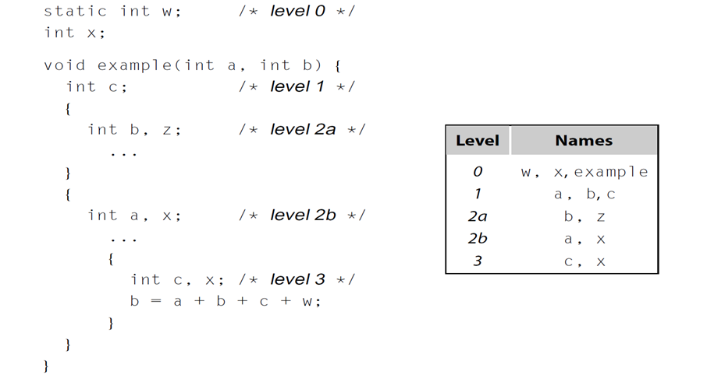
Dynamic Sheaf-of –Tables Example-2
Even Semester 2017-18
Nalinadevi Kadiresan

Slide 18
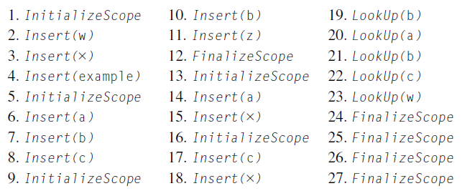
Implementing Lexically Scoped Symbol Tables- Dynamic Sheaf-of -Tables
Sequence of calls
Even Semester 2017-18
Nalinadevi Kadiresan

Slide 19
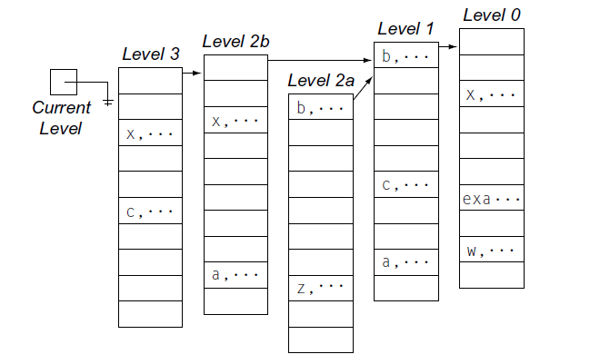
Implementing Lexically Scoped Symbol Tables- Dynamic Sheaf-of -Tables
Final table
Even Semester 2017-18
Nalinadevi Kadiresan

Slide 20
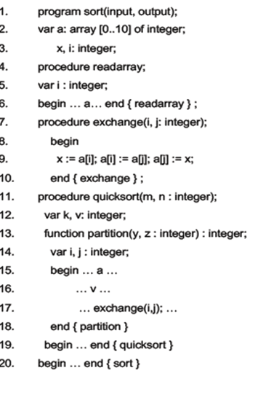
Implementing Lexically Scoped Symbol Tables-
Static Sheaf-of -Tables
Even Semester 2017-18
Nalinadevi Kadiresan

Slide 21
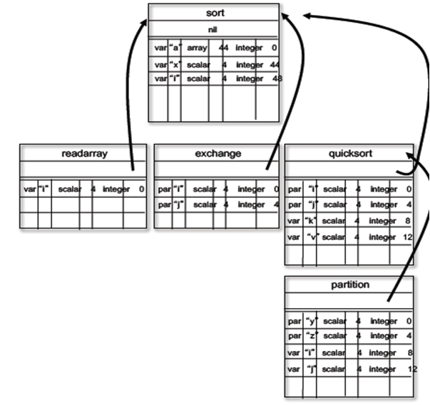
Even Semester 2017-18
Nalinadevi Kadiresan

Slide 22
Symbol Table
Proposed Implementation of lexically scoped symbol table
  Stack
  Sheaf-of-Tables
  Open Hashing
  Open Hashing + stack
  Open Addressing
  Two dimensional Hashed symbol Table
Notes:
A compiler uses a symbol table to keep track of scope and binding information about names. It is filled after the AST is made by walking through the tree, discovering and assimilating information about the names. There should be two basic operations – to insert a new name or information into the symbol table as and when discovered and to efficiently lookup a name in the symbol table to retrieve its information.
Two common data structures used for the symbol table are –
Linear lists:- simple to implement, poor performance
Hash tables:- greater programming/space overhead, good performance
Ideally a compiler should be able to grow the symbol table dynamically, i.e. insert new entries or information as and when needed. But if the size of the table is fixed in advance then ( an array implementation for example), then the size must be big enough in advance to accommodate the largest possible program.

Slide 23
Implementing Lexically Scoped Symbol Tables- Open Hashing

Slide 24
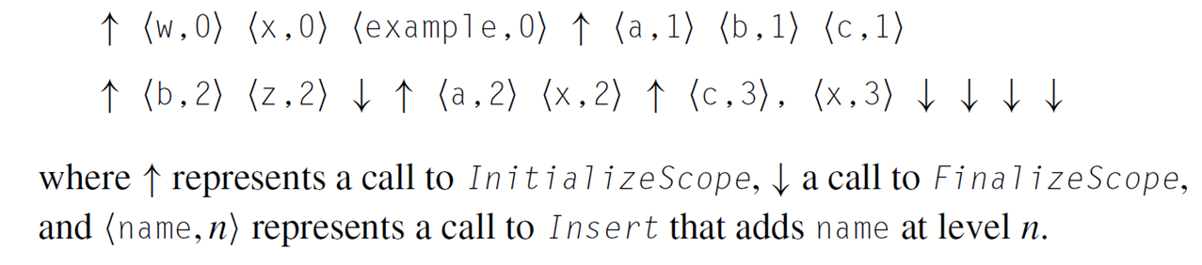
Implementing Lexically Scoped Symbol Tables- Open Hashing
Actions Generated for the code

Slide 25
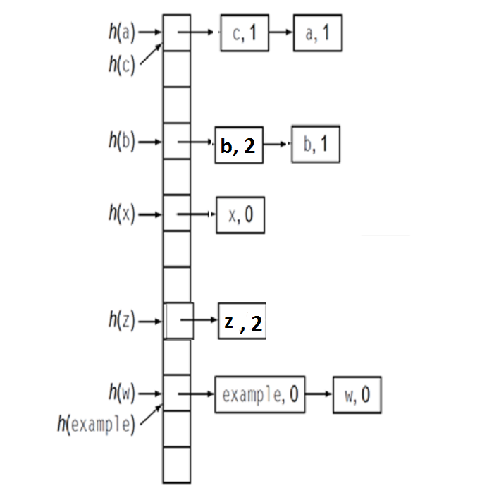
Implementing Lexically Scoped Symbol Tables- Open Hashing
Insert
  Checks for duplicates for each name (by comparing name and level) and inserts in the front of the chain
  Lookup
  Returns the first record discovered for a given name
  Initialize scope
  Puts a counter for the current lexical level
  Finalize scope
  Must decrement the current lexical level
  Find and Remove all the records for any names inserted in the scope being deallocated or
  Chain them together to preserve them

Slide 26
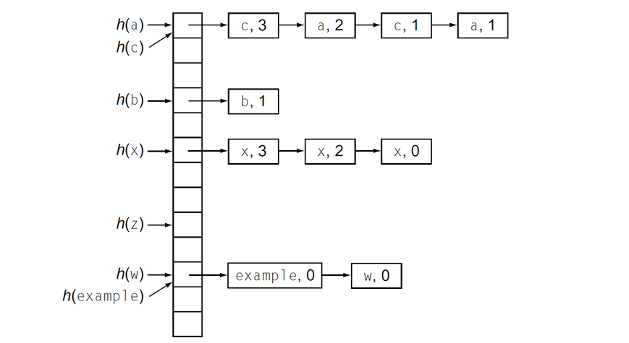
Implementing Lexically Scoped Symbol Tables- Open Hashing
Here, the finalizescope has deallocated the records of level 2a before entering into level 2b
However, if required the level 2a can be preserved before entering level 2b

Slide 27
Symbol Table
Proposed Implementation of lexically scoped symbol table
  Stack
  Sheaf-of-Tables
  Open Hashing
  Open Hashing + stack
  Open Addressing
  Two dimensional Hashed symbol Table
Notes:
A compiler uses a symbol table to keep track of scope and binding information about names. It is filled after the AST is made by walking through the tree, discovering and assimilating information about the names. There should be two basic operations – to insert a new name or information into the symbol table as and when discovered and to efficiently lookup a name in the symbol table to retrieve its information.
Two common data structures used for the symbol table are –
Linear lists:- simple to implement, poor performance
Hash tables:- greater programming/space overhead, good performance
Ideally a compiler should be able to grow the symbol table dynamically, i.e. insert new entries or information as and when needed. But if the size of the table is fixed in advance then ( an array implementation for example), then the size must be big enough in advance to accommodate the largest possible program.

Slide 28
Implementing Lexically Scoped Symbol Tables- Open Hashing + stack

Slide 29
Implementing Lexically Scoped Symbol Tables- Open Hashing +stack
Actions Generated for the code

Slide 30
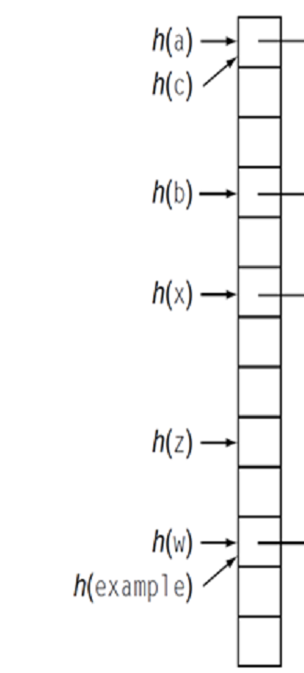
Implementing Lexically Scoped Symbol Tables- Open Hashing + Stack
z,2
b,2
c,1
b,1
a,1
example,0
x,0
w,0

Slide 31
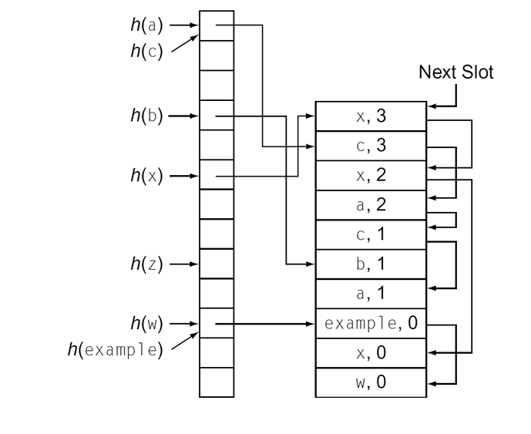
Implementing Lexically Scoped Symbol Tables- Open Hashing + Stack
Final table
Insert
  creates new level pointer if needed and inserts at nextFree
  For every hash value, inserts in the next free slot and update the chain.
Lookup
  Returns the first record discovered for a given name
Initialize scope
  Puts a counter for the current lexical level
FinalizeScope
  Iterates from top of the stack downwards to a level below the level being discarded
  Updates the index – set entry (Sets records pointer to next item in the chain)
  If records are discarded resets the pointer to next available slot or the records are preserved together on the stack preserve them

Slide 32
Symbol Table
Proposed Implementation of lexically scoped symbol table
  Stack
  Sheaf-of-Tables
  Open Hashing
  Open Hashing + stack
  Open Addressing + stack
  Two dimensional Hashed symbol Table
Notes:
A compiler uses a symbol table to keep track of scope and binding information about names. It is filled after the AST is made by walking through the tree, discovering and assimilating information about the names. There should be two basic operations – to insert a new name or information into the symbol table as and when discovered and to efficiently lookup a name in the symbol table to retrieve its information.
Two common data structures used for the symbol table are –
Linear lists:- simple to implement, poor performance
Hash tables:- greater programming/space overhead, good performance
Ideally a compiler should be able to grow the symbol table dynamically, i.e. insert new entries or information as and when needed. But if the size of the table is fixed in advance then ( an array implementation for example), then the size must be big enough in advance to accommodate the largest possible program.

Slide 33
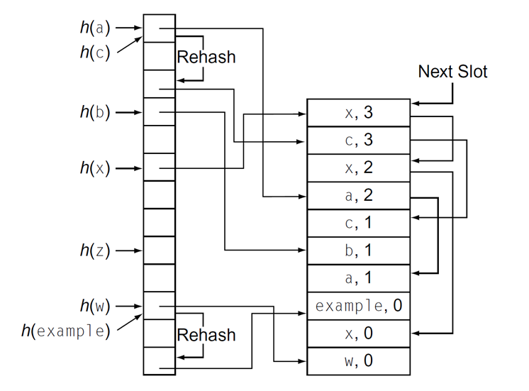
Implementing Lexically Scoped Symbol Tables- Open Addressing + stack

Slide 34
Implementing Lexically Scoped Symbol Tables- Open Addressing + stack
Insert
  Creates a new record on top of stack
  If older reference found, replaces the reference to the new record and links the old reference to the new record
Collisions
  Creates separate chain for collisions and redeclarations
  Collisions are threaded through the index set
  Redeclarations are threaded through the stack (Reduces the cost of lookup as more than one record need not be examined at a time
FinalizeScope
  Iterates over the top of stack (as in open hashing)
  To remove a record, updates the pointer to the older variant (if exists)
  To remove a final variant, inserts a reference to a designated deleted reference record
  Lookup must recognize the deleted reference occupying a slot in the current chain
  Insert must know if it can replace a deleted reference with a new symbol (reuse)
Even Semester 2017-18
Nalinadevi Kadiresan

Slide 35
Open hashing vs open addressing
Consider a bucket in open hashing with seven declarations for x and one declaration for y
  In open hashing Lookup encounters 7 x’s before finding y
  In open addressing Lookup encounters one record each for x and y

Slide 36
Symbol Table
Proposed Implementation of lexically scoped symbol table
  Stack
  Sheaf-of-Tables
  Open Hashing
  Open Hashing + stack
  Open Addressing
  Two dimensional Hashed symbol Table
Notes:
A compiler uses a symbol table to keep track of scope and binding information about names. It is filled after the AST is made by walking through the tree, discovering and assimilating information about the names. There should be two basic operations – to insert a new name or information into the symbol table as and when discovered and to efficiently lookup a name in the symbol table to retrieve its information.
Two common data structures used for the symbol table are –
Linear lists:- simple to implement, poor performance
Hash tables:- greater programming/space overhead, good performance
Ideally a compiler should be able to grow the symbol table dynamically, i.e. insert new entries or information as and when needed. But if the size of the table is fixed in advance then ( an array implementation for example), then the size must be big enough in advance to accommodate the largest possible program.

Slide 37
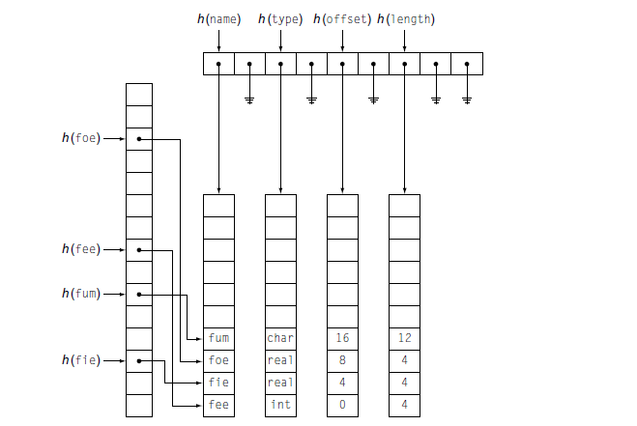
Implementing Lexically Scoped Symbol Tables-
Two Dimensional Hashed Symbol Table
Even Semester 2017-18
Nalinadevi Kadiresan

